Slide 1

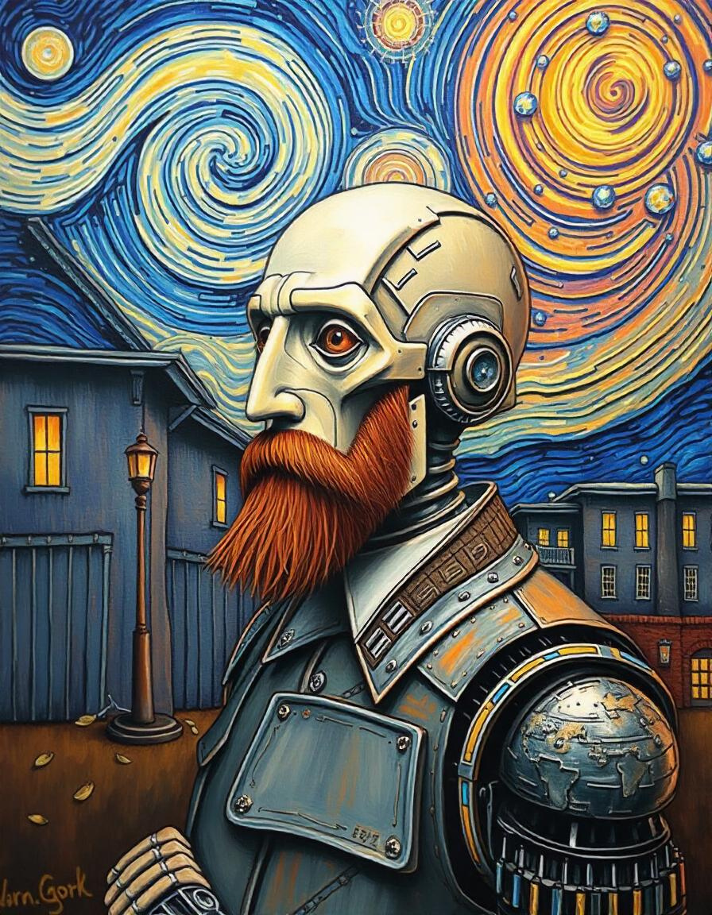
Artificial Vincent
Van Gogh
Our ideal goal is to create new and unique images of Christianity that embody Van Gogh's later style and expression.

Slide 2
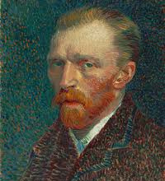
Project
Overview
Our project leverages the power of GANs & Neural Style
Transfer to analyze and learn from a comprehensive data
set of Van Gogh's paintings. By training on this data, our model
aims to generate new, unique Style images that
capture the essence of Van Gogh's post-
impressionist style, including his bold color choices,
expressive brushstrokes, and emotive compositions.

Slide 3
Project Objectives
The primary objectives of this project are
Developing
Analysis
exploring
contributing
To develop a GAN
model capable of
generating high-quality
images in the style
of Vincent van Gogh.
understand the key
elements of Van Gogh's
artistic style that can
be captured and
reproduced by AI.
the potential and
limitations of AI
in replicating and
extending human
creativity.
to the ongoing
dialogue about the
role of artificial
intelligence in art
and creativity.

Slide 4
Project Levels
Data Collection
Data Preprocessing
This section outlines our data collection process. we collect fake & real data.
This section outlines our data collection process,
Building Model
Interface
Tdesigned to capture and reproduce the unique stylistic elements of Van Gogh's artwork.
an interface to interact with model in an
interactive way and display the results.

Slide 5
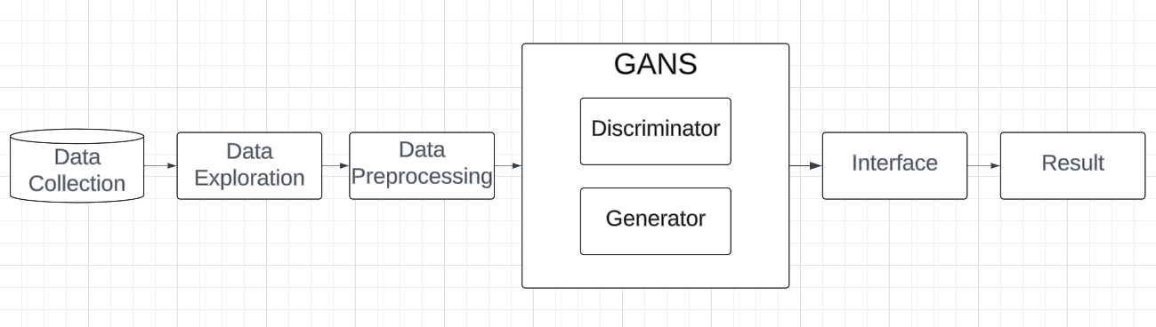
Project Levels

Slide 6
Data Collection
Van Gogh Museum
Amsterdam: Provided high-resolution images of their extensive collection.
Google Arts & Culture
Provided access to high-quality images from various museums worldwide.
The official Van Gogh project While primarily textual, sketches and paintings mentioned in Van Gogh's correspondence.
The Complete Paintings
by Ingo F. Walther and Rainer Metzger: Used for cross-referencing and filling gaps in digital sources.

Slide 7
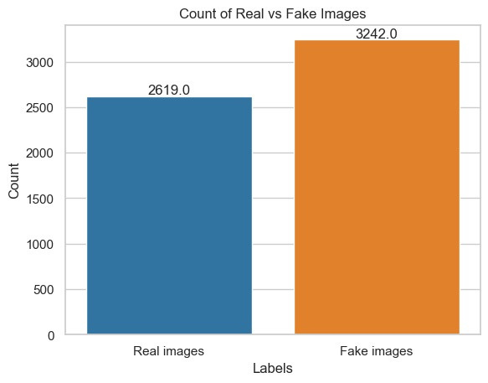
Data Exploration
This bar chart shows the distribution of real versus fake images in a dataset, with counts for each category. Here's a breakdown of the key elements and an exploration based on this data:
- Real images: 2,619
-Fake images: 3,242
The dataset appears to be imbalanced, with more fake images than real images.

Slide 8
Data Preprocessing
Stage 1
Segmentation
Resized all images to Converted
all images (64 x 64) to RGB format
padding where necessary.
Standrization
Augmentation
Segmentation
For larger paintings, we created
multiple segments to capture
details at various scales.

Slide 9

GAN Model
Our project utilizes a custom Generative Adversarial Network (GAN) architecture designed specifically to capture and reproduce the unique stylistic elements of Van Gogh's artwork. This section details the overall architecture and the specific designs of the generator and discriminator networks.
Generator Network Design
Discriminator Network Design
View More

Slide 10
Generator
1.Mapping Network
8-layer MLP that transforms a random latent vector into an intermediate latent space (W).
Helps in disentangling various aspects of the generated images.
2.Synthesis Network
Consists of multiple resolution-specific blocks (64 x 64).
3.Van Gogh Style Block
Custom convolutional layers with dilated convolutions to capture broad brush strokes.
4.Skip Connections
Allows for better preservation of both fine and coarse details

Slide 11
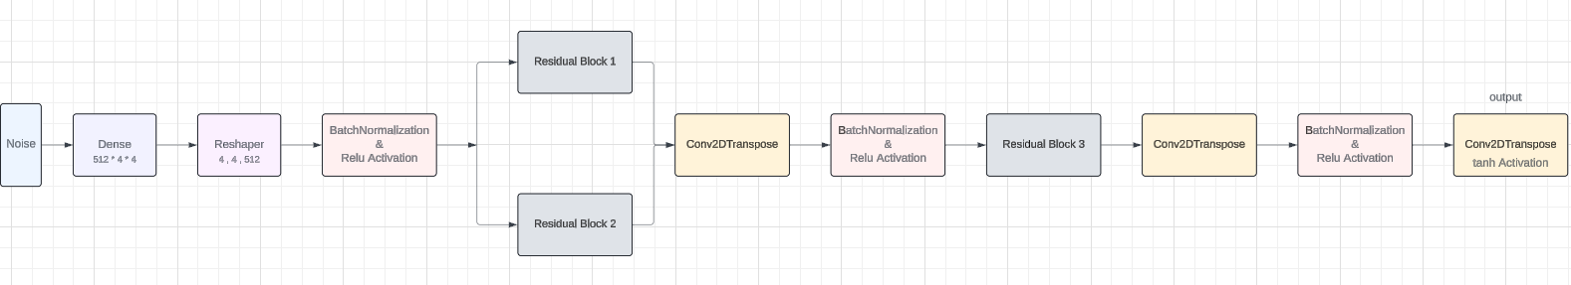
Generator

Slide 12
Discriminator
1.Progressive Growing Structure:
Multiple resolution-specific blocks (64 x 64).
Each block includes downsampling layers and residual connections.
2.Minibatch Standard Deviation:
Introduced in the final layers to increase variation in generated images.
3.Adaptive Discriminator Augmentation (ADA):
Dynamically applies augmentations to both real and generated images during training.
Augmentations include color transformations, geometric distortions, and noise injection.
4.Custom "Van Gogh Authentication Block":
Specialized convolutional layers designed to identify Van Gogh-specific features like brushstroke patterns and color usage.

Slide 13
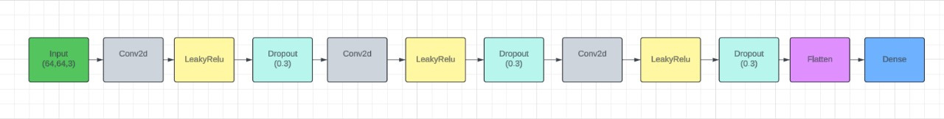
Discriminator

Slide 14
Interface
we created an User interface (UI) for an application related to artificial style transfer & GANS based on Vincent Van Gogh's artwork to interact with our model that built-in Dash & Keras.

Slide 15
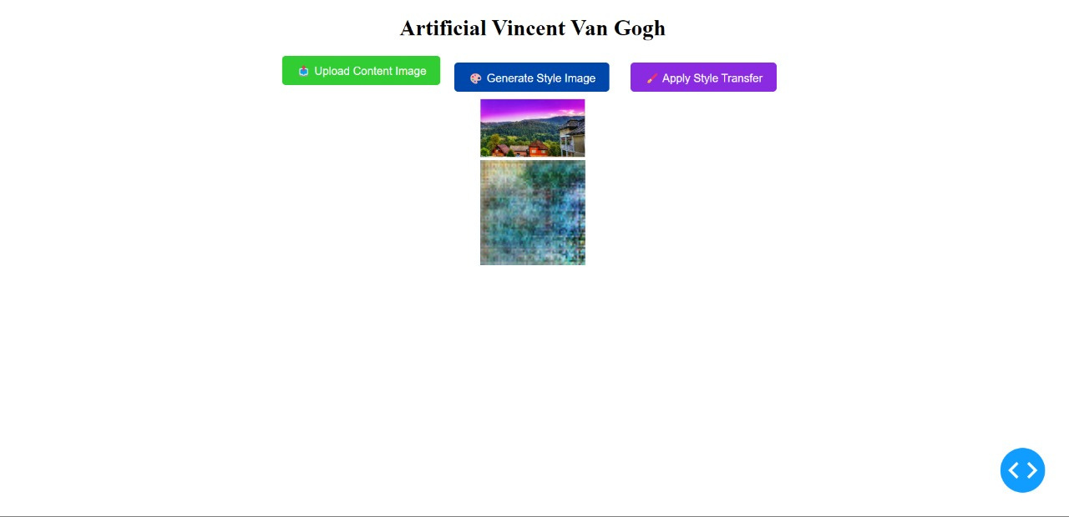
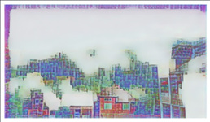
Interface

Slide 16
Future Work
Our project utilizes a custom Generative Adversarial Network (GAN) architecture designed specifically to capture and reproduce the unique stylistic elements of Van Gogh's artwork. This section details the overall architecture and the specific designs of the generator and discriminator networks.

Slide 17
Team Members
Youssef Hussiny
Boules Ashraf
Abdallah Beshary
Shahd Alaa
Mariam Safwat
Mahmoud Abdelawal

Slide 18
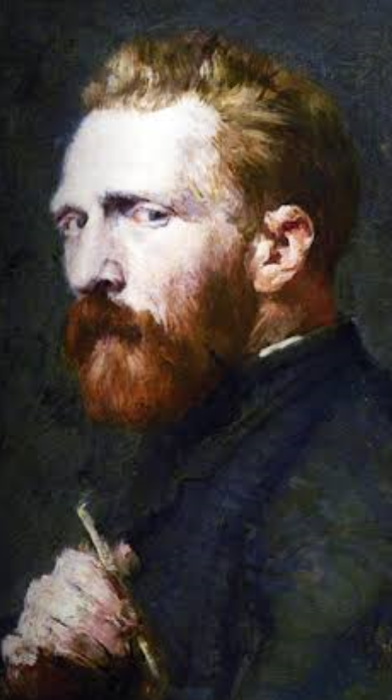
Quote
“What would life be
if we had no courage
to attempt anything ?”
Vincent Van Gogh

Slide 19
Thanks For Watching

